Slide 1
SECURE DATA HIDING IN IMAGE USING STEGANOGRAPHY
Presented By: Samay Salunkhe
Student Name : Samay Salunkhe
College Name & Department : Padmashri Manibhai Desai College,Computer Science

Slide 2
OUTLINE
Problem Statement
Technology used
Wow factor
End users
Result
Conclusion
Git-hub Link
Future scope

Slide 3
Problem Statement
Data Safety: How can we ensure that hidden data in images stays secure and can't be accessed or altered by unauthorized people?
Maximizing Storage: What methods can we use to hide more data in an image without affecting its quality or appearance?
Resistance to Attacks: How can we develop techniques to protect hidden data from being compromised by image compression or other modifications?
Practical Applications: How can steganography be applied in real-world scenarios for secure communication and data protection?

Slide 4
Technology used
Python: The core programming language for implementing steganography algorithms.
OpenCV: A powerful library for image processing and computer vision tasks.
NumPy: A library for numerical operations, used for manipulating image data.
Cryptography: A library for encryption and decryption to enhance data security.
Tkinter/PyQt: Libraries for creating graphical user interfaces to make the tool user-friendly.

Slide 5
Wow factors
Advanced Security: It incorporates encryption to enhance the security of hidden data, making it more robust against attacks.
Efficient Algorithms: Utilizes optimized algorithms for real-time data hiding and extraction, ensuring quick and practical use.
High Capacity: Maximizes the amount of data that can be hidden in an image without compromising its quality.
Versatility: Supports multiple image formats and can be applied to various real-world scenarios for secure communication and data protection.

Slide 6
End users
Government Agencies: To securely transmit sensitive information without detection.
Businesses: For protecting confidential data and secure communication.
Journalists and Whistleblowers: To safely share sensitive information.
Individuals: For personal privacy and secure communication.
Educational Institutions: For research and teaching purposes in cybersecurity and cryptography.

Slide 7
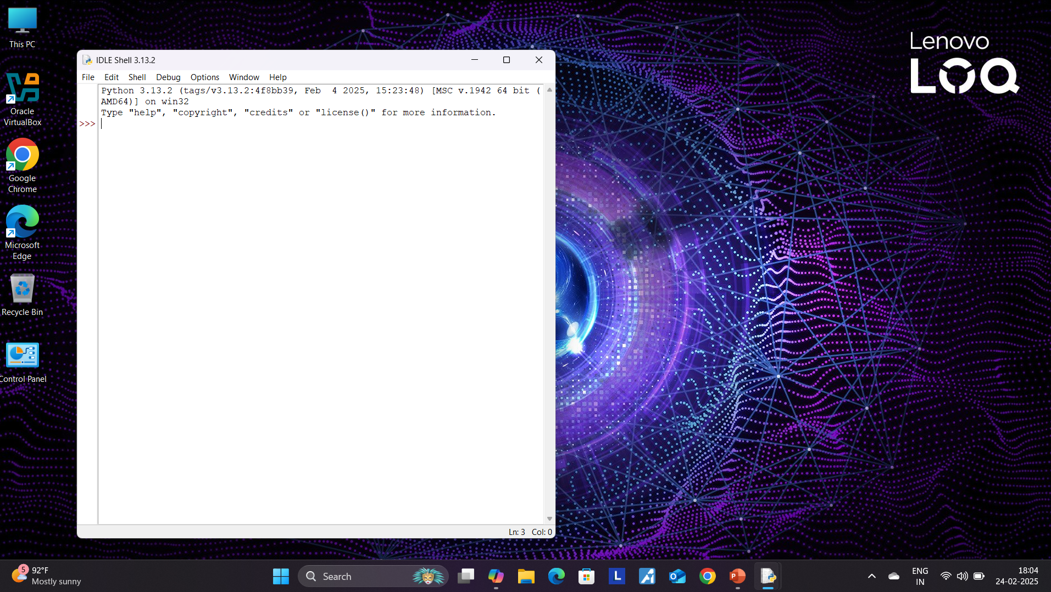
Results - 1.open python idle

Slide 8
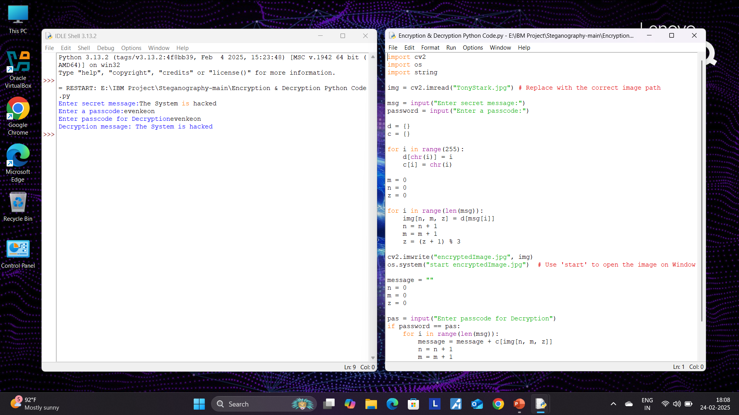
Results- 2.run the code & give secret message & Passcode

Slide 9
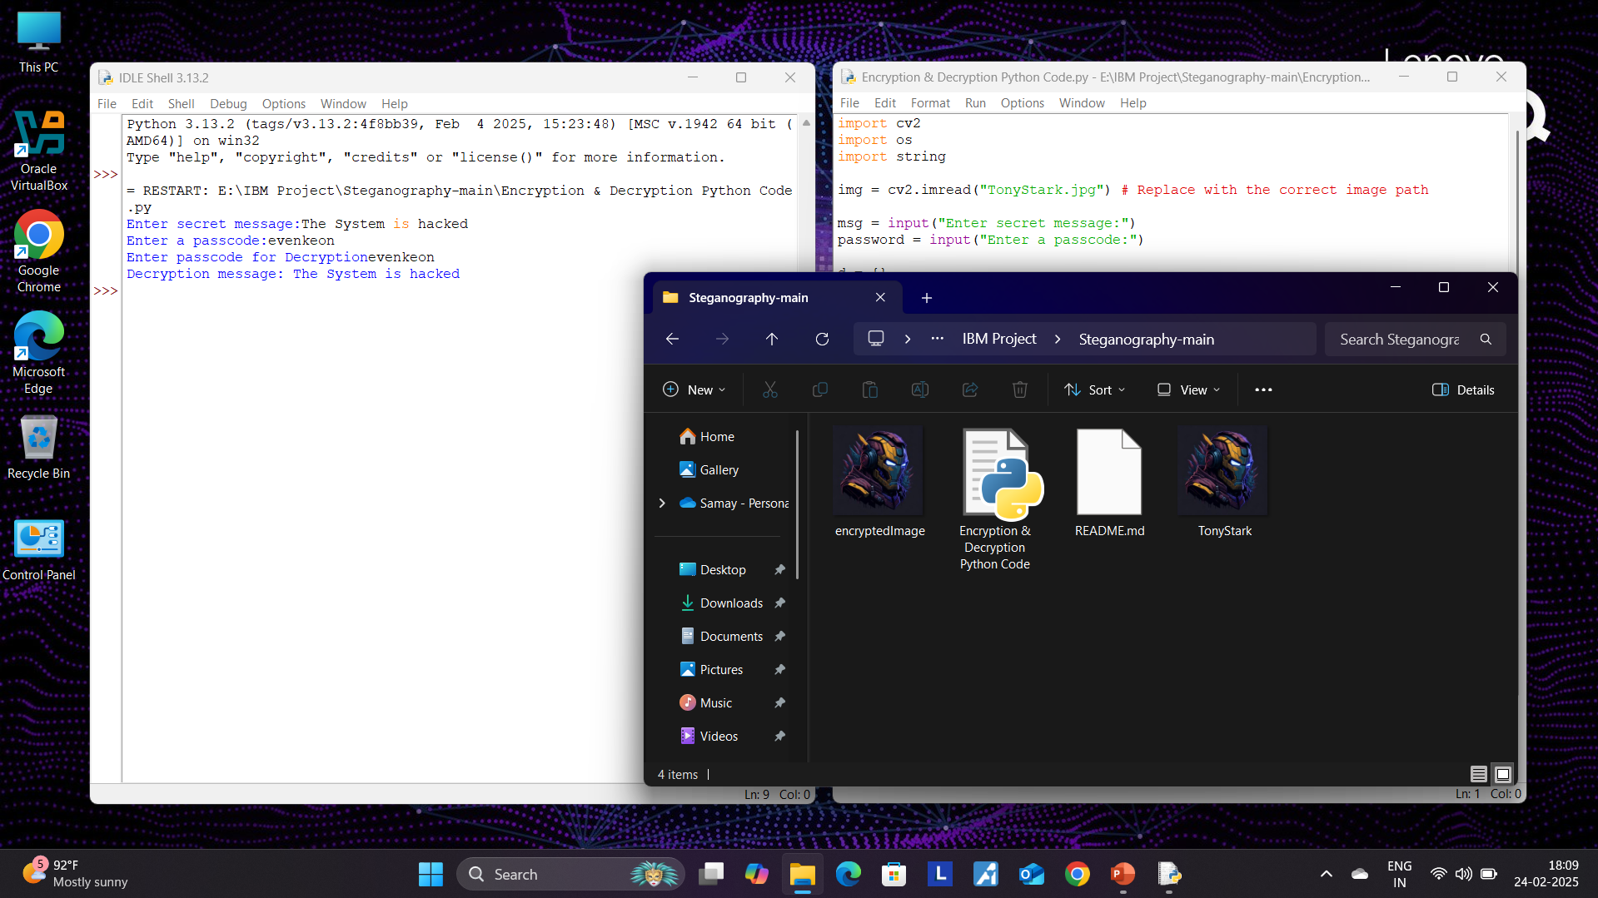
Results- 3.the image encypted

Slide 10
Conclusion
In our project, we successfully implemented and demonstrated the effectiveness of steganography as a method for securing data. By embedding confidential information within digital images, we provided an additional layer of security, ensuring that sensitive data remains hidden from unauthorized access. This technique offers a practical and innovative solution for data protection, making it a valuable tool in the field of information security.

Slide 11
GitHub Link
https://github.com/evenkeon/Steganography.git

Slide 12
Future scope
Enhanced Encryption: Implementing advanced encryption algorithms like AES for added security.
Mobile and Web Integration: Developing applications for mobile and web platforms to make steganography more accessible.
AI-based Security: Using AI to detect tampering and enhance the security of hidden data.
Adding multiple layers of encryption for extra security.

Slide 13
THANK YOU

